Slide 1
Capstone Project NYC Taxi Trip Prediction
Play Store App Review Analysis Team members Akshay Kumar Saini Kumkum Singh

Slide 2

Index
About NYC TLC
Project Road Map
Business Problem
Purpose of the project
Data Pipeline
Data Summary
Exploratory Data Analysis
Feature Selection
Dataset For modeling
Machine Learning Algorithm
Model Validation and Selection
Conclusion

Slide 3
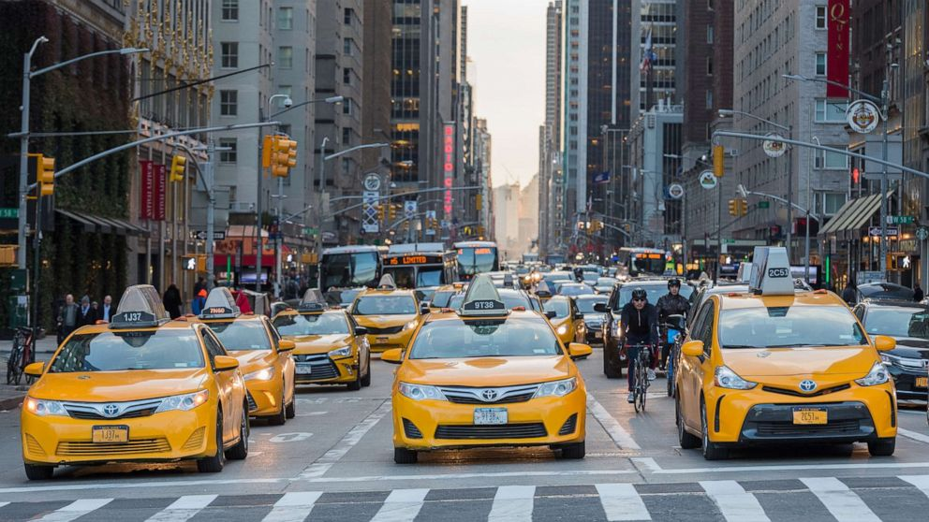
The New York City Taxi and Limousine Commission
The New York City Taxi and Limousine Commission (TLC), created in 1971, is the agency responsible for licensing and regulating New York City's Medallion (Yellow) taxi cabs, for-hire vehicles (community-based liveries, black cars and luxury limousines), commuter vans, and paratransit vehicles.

Slide 4
Project Road Map
Business Problem
Project Aim
Data Understanding
Exploratory Data Analysis
Cleaning Dataset
Feature Selection
Machine Learning Models
Model Validation
Conclusion

Slide 5
Business Problems
The NYC Taxi and Limousine Commission want to predict trip duration of their rides

Slide 6
Purpose of the Project
The Purpose of this project is to built a machine learning model which predict the trip duration in the New York city.

Slide 7
Data Pipeline
Data Processing
Exploring Dataset
EDA
Identifying relation between dependent and independent variable
Data Preparation
ML Model
Cleaning Data by removing outlier and creating new feature
Applying Different Regression Algorithm on the Dataset

Slide 8
Data Summary
Id
a unique identifier for each trip
vendor_id
a code indicating the provider associated with the trip record
pickup_datetime
date and time when the meter was engaged
trip_duration
dropoff_datetime
date and time when the meter was disengaged
passenger_count
the number of passengers in the vehicle (driver entered value)
pickup_longitude
the longitude where the meter was engaged
pickup_latitude
the latitude where the meter was engaged
dropoff_longitude
the longitude where the meter was disengaged
dropoff_latitude
store_and_fwd_flag
the latitude where the meter was disengaged
This flag indicates whether the trip record was held in vehicle memory before sending to the vendor
duration of the trip in seconds

Slide 9
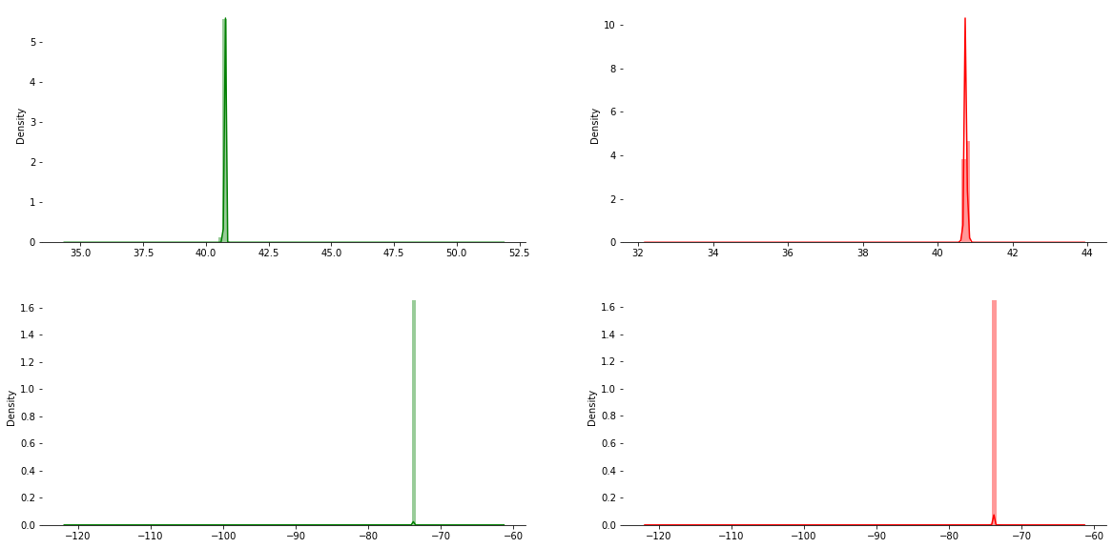
Dealing with Outlier
1. Latitude and Longitude
These Plot show that the most of the trips are around the following coordinates
Latitude: 40 to 41
Longitude: -73 to -74
There are outlier like 32 and 50
We will remove the outlier using bound method

Slide 10
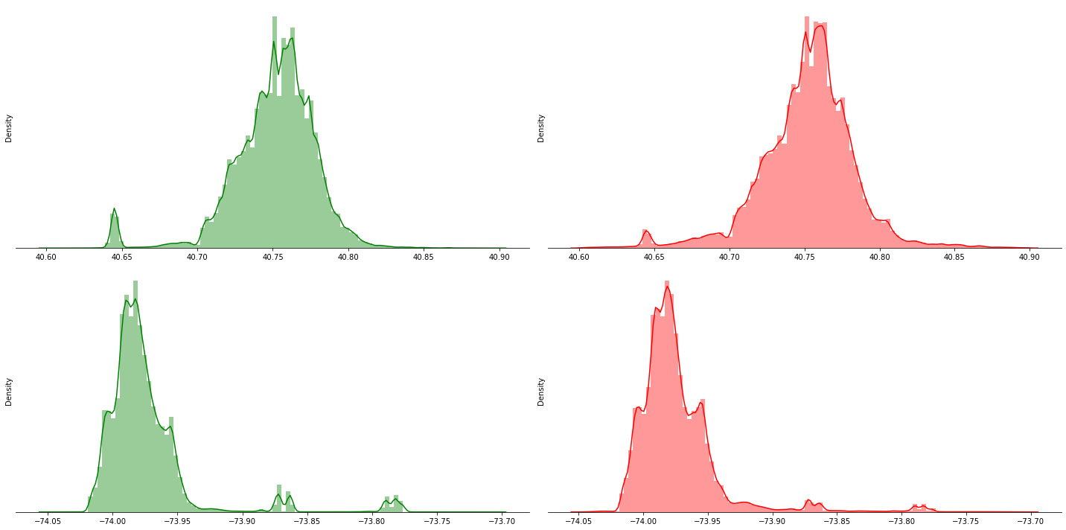
Dealing with Outlier
After removing outlier from Latitude and Longitude
After Cleaning Latitude and longitude we can clearly see most of the trip occur around 40.7128, 74.0060 region
New Feature Creation
Created Feature Distance(calculated from pickup and dropoff point) using geopy distance

Slide 11
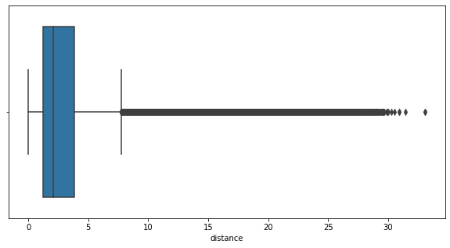
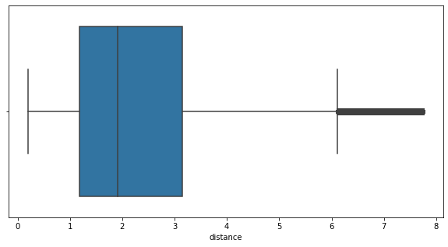
Dealing with Outlier
Distance
Box Plot of Distance(It has a number of outlier)
Box Plot of Distance after cleaning using IQR method(Very Less Outlier)

Slide 12
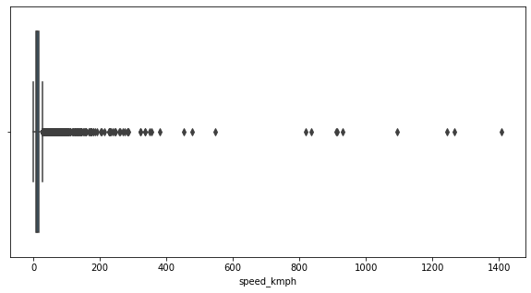
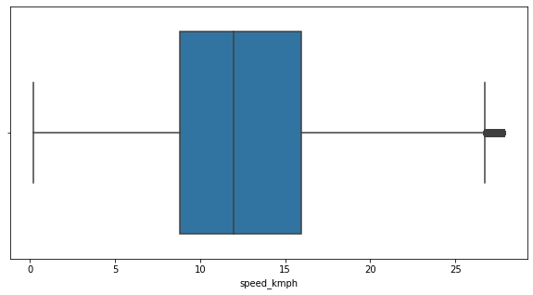
Dealing with Outlier
Feature Creation(Speed) using Distance and trip time and cleaning
Box Plot of Speed(It has a number of outlier)
Box Plot of Speed after cleaning using IQR method(Very Less Outlier)

Slide 13
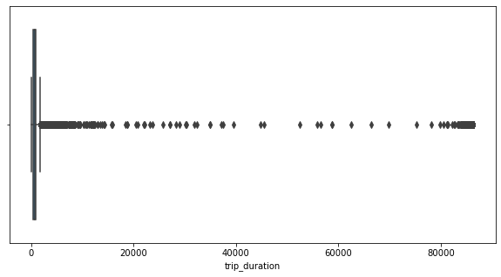
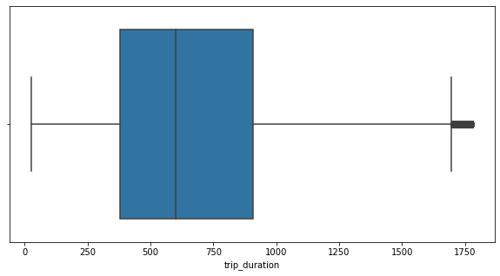
Dealing with Outlier
Trip Duration
Box Plot of Trip Duration(It has a number of outlier)
Box Plot of Trip Duration after cleaning using IQR method(Very Less Outlier)

Slide 14
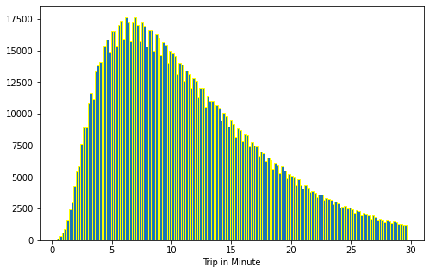
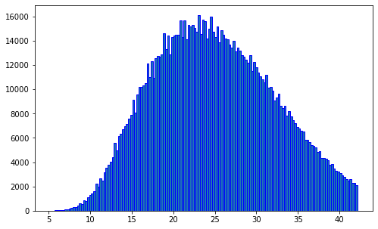
Transforming Data
Trip Duration
From above plot we can se data is positively skewed
Data after applying Square Root Transformation

Slide 15
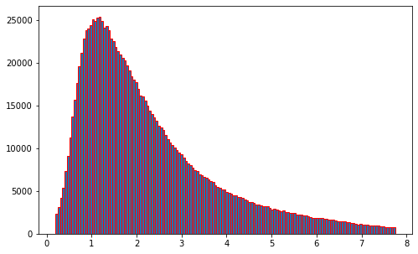
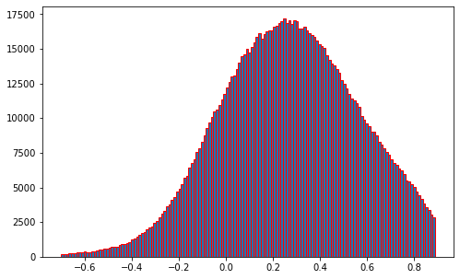
Transforming Data
Distance
From above plot we can se data is positively skewed
Data after applying log10 Transformation

Slide 16
Feature Engineering
Pickup day & Dropoff day
Contains the name of the weekdays
Pickup day no & Dropoff day no
Convert weekday into number start at Monday = 0 and end at Sunday=6
Pickup hour & Dropoff hour
Pickup month & Dropoff month :
Distance
Speed
Day part(Dividing 24 hours into four parts)
Morning (from 6:00 am to 11:59 pm)
Afternoon (from 12 noon to 3:59 pm)
Evening (from 4:00 pm to 9:59 pm)
Late Night (from 10:00 pm to 5:59 am)
Extracting hour.
Extract month in number.
Calculate the distance with the help of latitude and longitude (km)
Calculated speed distance/trip duration (km/hr)

Slide 17
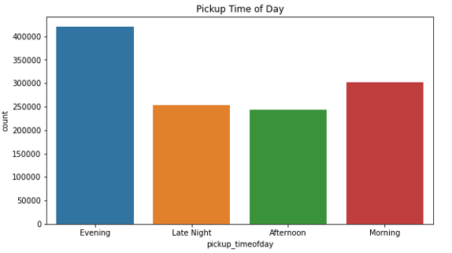
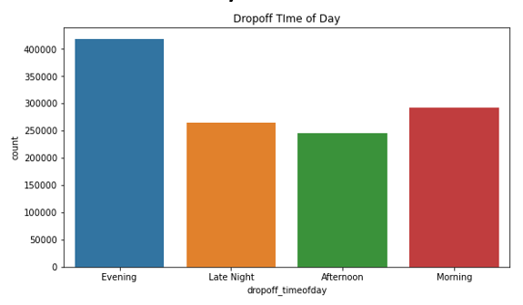
Exploratory Data Analysis
1st Plot
From this plot we can see most of the trips begin at Evening followed by Morning
In afternoon we have the least number of Rides
2nd Plot
From this plot we can see most of the trips end at Evening followed by Morning
In afternoon we have the least number of Rides

Slide 18
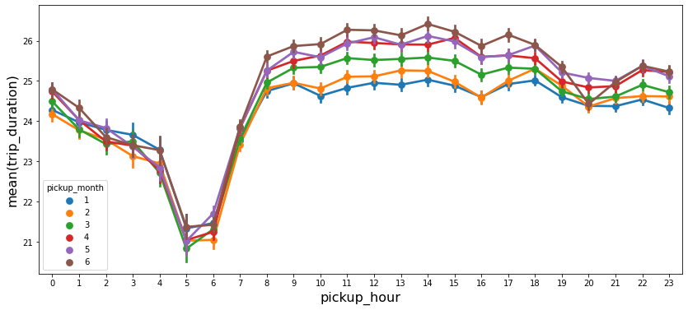
Exploratory Data Analysis
From this plot we can see the variation in the trip duration with respect to Pickup Hour for each Month
There are least number of trips at 5-6 AM.
And the Traffic is at peak or maximum trip at 12AM to 4 PM (Afternoon).
We will create new Feature of Is Trip start from Afternoon or not.

Slide 19
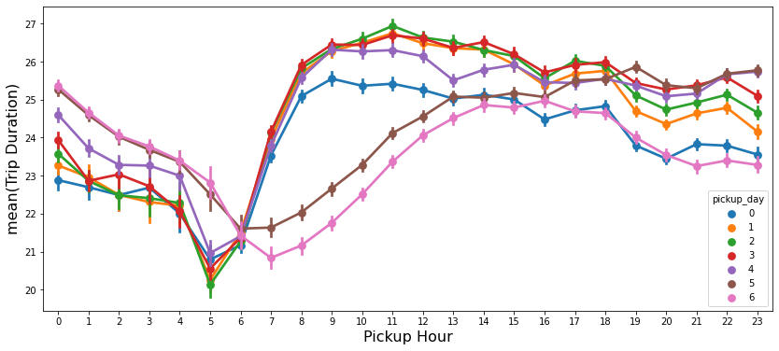
Exploratory Data Analysis
From this plot we can see the variation in the trip duration with respect to Pickup Hour for Day (Mon-Sun)
From the Plot we can see that There are very less number trips on Saturday(5) and Sunday(6)
As those are non working days, that can be the reason for the less trips

Slide 20
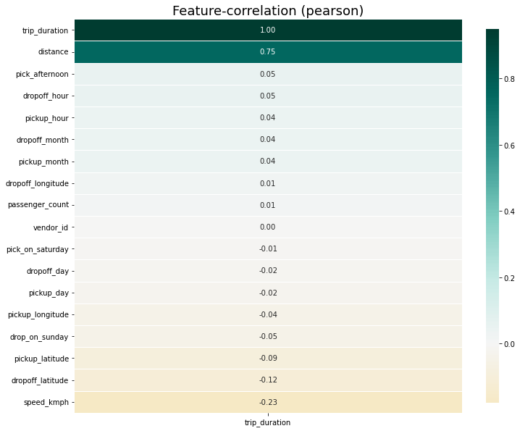
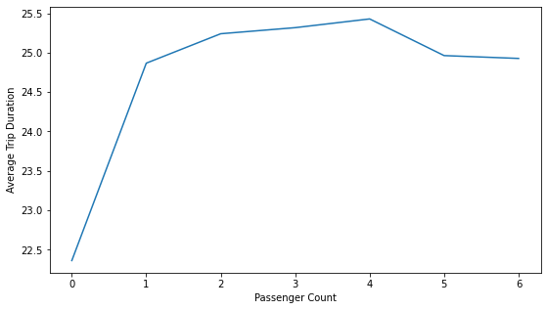
Exploratory Data Analysis

Slide 21
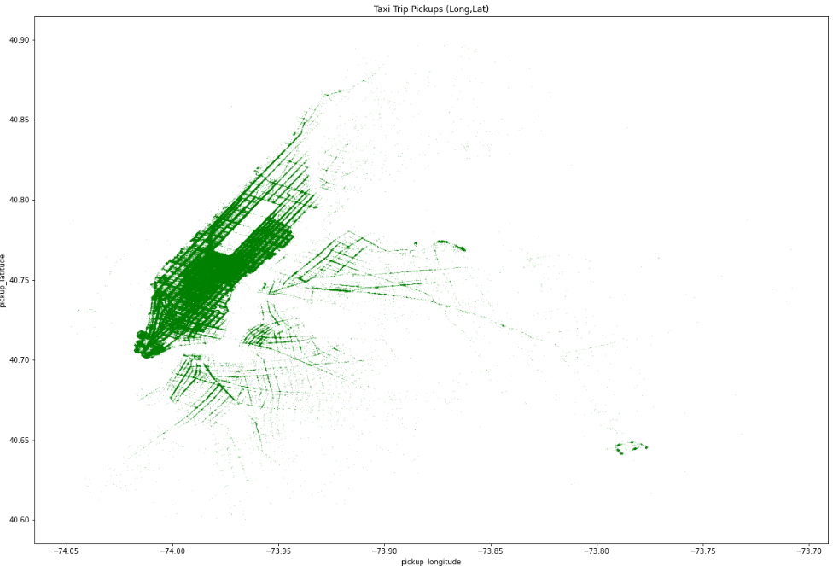
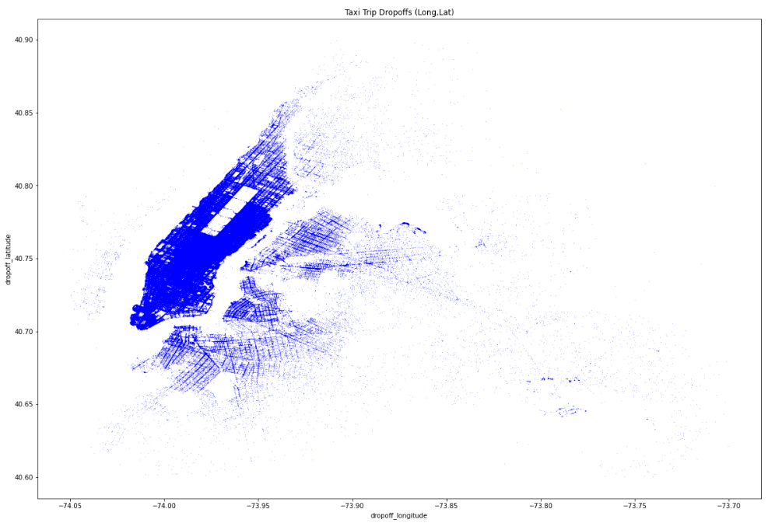
Exploratory Data Analysis
Pick Up Location
Dropoff Location

Slide 22
Feature Selection
'distance’,
'passenger_count’,
'pickup_day’,
'pickup_latitude’,
'pickup_longitude’,
'pickup_month’,
'pickup_timeofday_Afternoon’,
'pickup_timeofday_Evening’,
'pickup_timeofday_Late Night’,
'pickup_timeofday_Morning’,
'speed_kmph'}

Slide 23
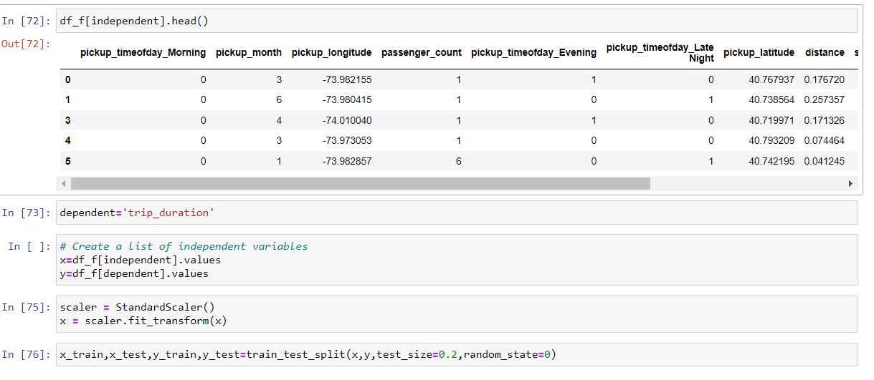
Dataset For modeling

Slide 24
Machine Learning Models
Models
Linear Regression
Lasso Regression
Ridge Regression

Slide 25
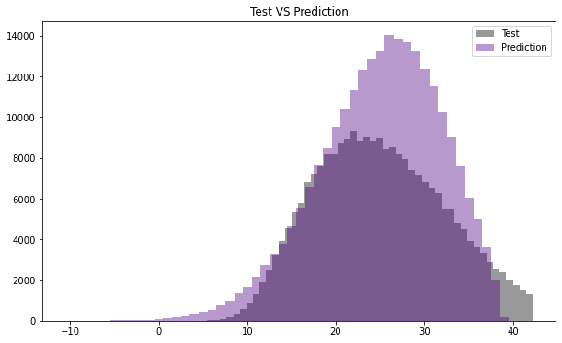
Linear Regression
Linear
Linear regression performs the task to predict a dependent variable value (y) based on a given independent variable (x)
Error Matrices | Train Data | Test Data
MSE | 4.1622 | 4.1975
R Square | 0.9197 | 0.9191

Slide 26

Lasso Regression
Lasso
Lasso is a modification of linear regression, where the model is penalized for the sum of absolute values of the weights
Error Matrices | Train Data | Test Data
MSE | 4.1622 | 4.1975
R Square | 0.9197 | 0.9191

Slide 27

Ridge Regression
Ridge
Ridge regression is a method of estimating the coefficients of multiple-regression models in scenarios where the independent variables are highly correlated.
Error Matrices | Train Data | Test Data
MSE | 4.162210 | 4.197518
R Square | 0.919727 | 0.919117

Slide 28
Model Validation and Selection
As All the three model have almost Equal kind of accuracy
We can choose any one of them
Model | Train MSE | Train R^2 | Test MSE | Test R^2
0 | Linear Regression | 4.162214 | 0.919727 | 4.197509 | 0.919117
1 | Lasso Regression | 4.162210 | 0.919727 | 4.197518 | 0.919117
2 | Ridge Regression | 4.162210 | 0.919727 | 4.197518 | 0.919117

Slide 29
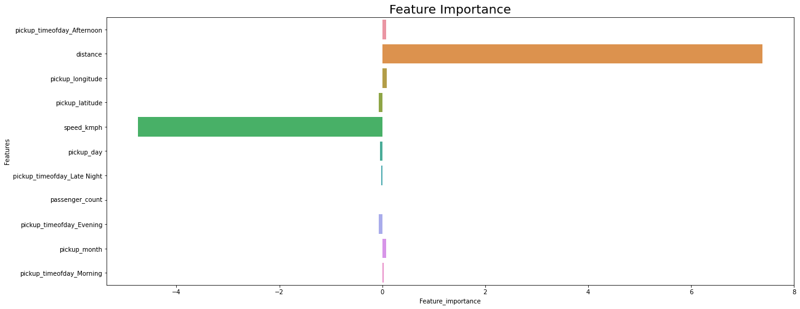
Important Feature

Slide 30
Conclusion
We can see that MSE and R2 which are the metrics used to evaluate the performance of regression model of Linear Regression, Lasso, Ridge
The Linear models show good performance on our training and testing environment
From above table we can conclude that Linear Model gives us R2=91%. Which is the best model as compare to the other models to predict trip duration for a NYC taxi.

Slide 31
Thankyou

